Slide 1

Employee Attrition Analysis
Presented by,
Sajni Bhadaja

Slide 2

Slide Title
Problem Statement
Project Overview – Introduction
End Users
Wow Factor in Project
Modelling/Block Diagram/Flow of Project
Result/outcomes
Conclusion
Future Perspective

Slide 3

Problem Statement

Slide 4
High attrition negatively impacts productivity, morale, and operational continuity.
Increased costs for recruitment, training, and onboarding.
Loss of experienced talent and institutional knowledge.
Need for data-driven insights to reduce employee turnover.

Slide 5


Project Overview
Introduction
End Users
Analyze employee attrition using a dataset of 1,000 employees.
Data includes demographics, job roles, satisfaction, salary, tenure, promotions, and attrition status.
Use Python (Pandas, Seaborn, Matplotlib) for data analysis and visualization.
Objective: Identify factors influencing attrition and suggest solutions.
HR Managers – for policy changes and retention planning.
Business Analysts – for employee-related performance metrics.
Organizational Development Teams – to design engagement initiatives.
Executives – for strategic workforce management decisions.

Slide 6
Wow Factor in Project
🎯 Purpose-Driven EDA: Each plot answers a real HR
question.
📊 Visual Storytelling: Clean, insight-rich visualizations
For satisfaction, salary, tenure, and department-wise
attrition.
🔁 End-to-End Pipeline: From raw data to actionable
recommendations.
🔧 Scalable Design: Ready for predictive modeling or
dashboard deployment.

Slide 7

Modelling/Block Diagram/Flow of Project
Flow of Project:
Data Loading & Cleaning
Exploratory Data Analysis
Visualizations (Attrition, Satisfaction, Work Hours, etc.)
Insight Generation
Strategic Recommendations

Slide 8
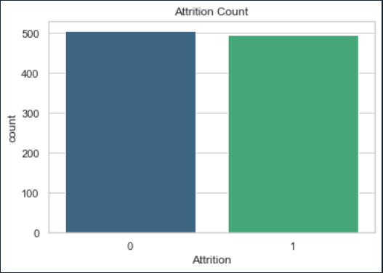
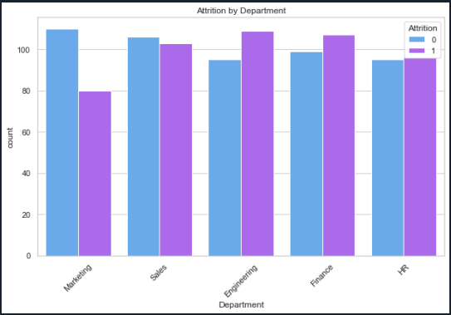
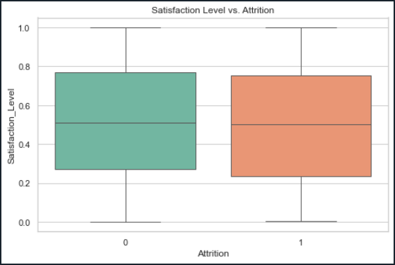
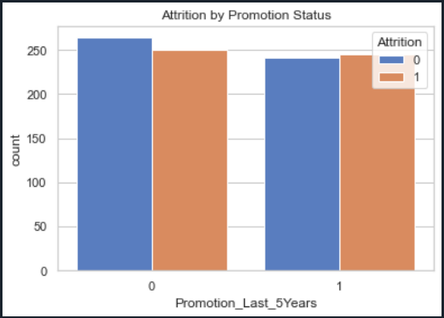
Some Attrition Analysis Charts
Visualization: Boxplot shows how satisfaction levels differ between employees who left and stayed.
Finding: Lower satisfaction correlates with higher attrition (as mentioned in your report).
Insight: Looks at how recent promotions (last 5 years) affect attrition.
Finding: Those without promotions may have a higher likelihood of leaving.
Attrition Rate
Departmental Attrition
Calculated Mean Attrition: The script computes the attrition rate as the mean of the Attrition column(likely encoded as 0/1).
Insight: Provides a general view of turnover.
Satisfaction vs. Attrition
Visualization: Count plot per department with attrition overlay.
Finding: Identifies departments with higher turnover (important for HR interventions).
Impact of Promotions

Slide 9
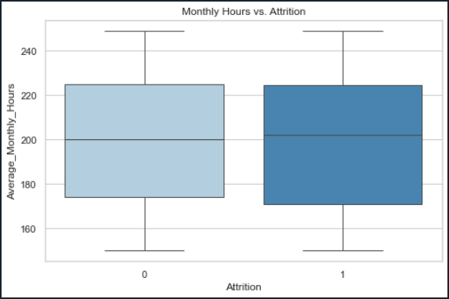
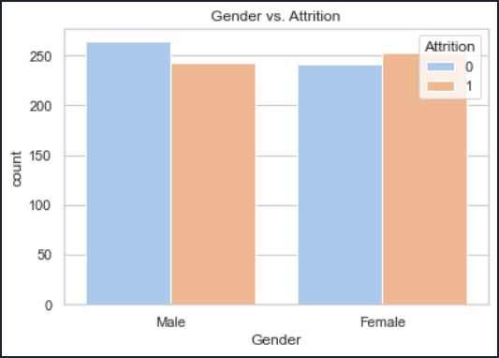
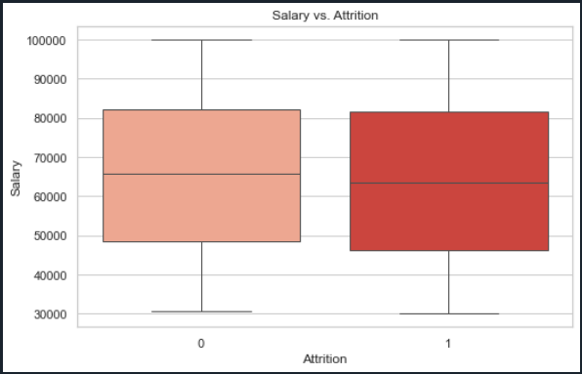
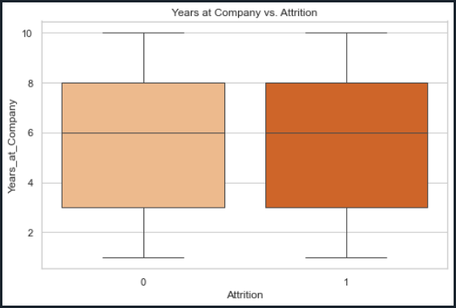
Some Attrition Analysis Charts
Insight: Salary distributions visualized against attrition.
Finding: Possibly reveals if lower-paid employees leave more frequently.
Insight: Shows how long-tenure correlates with retention.
Finding: Often, longer tenure is tied to lower attrition risk.
Work Hours and Attrition
Gender and Attrition
Salary Distribution and Attrition
Years at Company vs. Attrition
Insight: Compares monthly hours across attrition statuses.
Finding: Overwork might be linked to attrition.
Insight: Compares attrition between male and female employees.
Finding: Checks for disparities that might need addressing.

Slide 10
Result/Outcomes
Identified departments and roles with highest attrition rates.
Found strong correlation between low satisfaction and turnover.
Highlighted impact of promotions, workload, and salary levels.
Recommendations proposed for boosting retention and employee morale.

Slide 11

Conclusion
By analyzing key variables, this project reveals crucial patterns behind employee attrition.
The insights enable data-backed HR decisions, reducing turnover risk and improving workforce stability.

Slide 12
Future Perspective
Add machine learning models to predict at-risk
employees.
Build an interactive dashboard for HR managers
(e.g., Streamlite, Power BI).
Extend to other workforce datasets for broader impact.

Slide 13



